Slide 1
Depth Learning
Unsupervised Monocular Depth Learning in Dynamic Scenes
Li, Hanhan, et al. Conference on Robot Learning. PMLR, 2021.
221206
Advanced Computer Vision
Sohee Kim

Slide 2
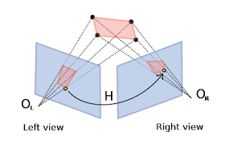
Li, Hanhan, et al. "Unsupervised monocular depth learning in dynamic scenes." Conference on Robot Learning. PMLR, 2021.
Introduction
Estimating depth and object motion in 3D given a monocular video stream
Generally, relies on prior knowledge – provided by deep networks, that can learn the priors through training on large collections of data
Self-supervised methods (rely on monocular video itself for supervision) have been attracting increasing attention
Learning of depth estimation : Based on principles of SFM (structure from motion) = Same scene, observed from 2 different positions
Approaches Rely on Additional cues
Additional information : Semantics (의미)
Auxiliary(보조) segmentation model : capable of segmenting out all classes of movable objects to appear in the video
Utilize different types of prior knowledge
A common case : the observing car follows another car, at the same velocity = observed car appears static
Godard et al. – exclude these regions from loss
The method remains limited to only one specific type of object motion
Optical flow is learned jointly with depth, unsupervised
However, stereo input is used
Challenges
Texture less areas
Occlusions
Reflections
Moving objects
Notes:
Estimating depth and object motion in 3D given a monocular video stream is an ill-posed problem, and generally heavily relies on prior knowledge. The latter is readily provided by deep networks, that can learn the priors through training on large collections of data.
~~, due to the virtually unlimited abundance of unlabeled video data.
Occlusions : 영상 폐색 영역. 가려지는 부분

Slide 3
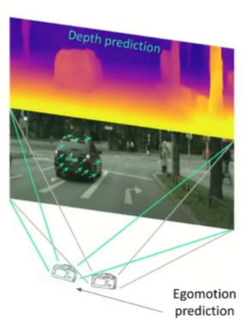
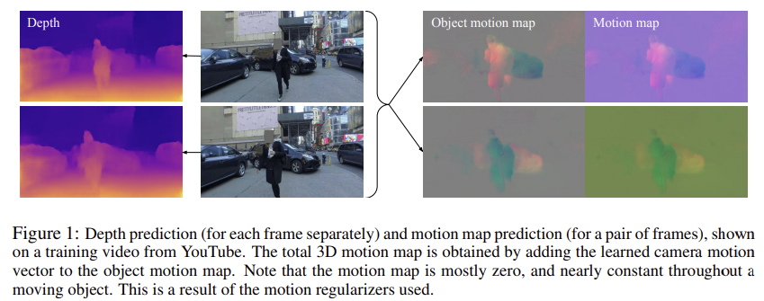
Li, Hanhan, et al. "Unsupervised monocular depth learning in dynamic scenes." Conference on Robot Learning. PMLR, 2021.
Introduction
⇒ A method for learning jointly depth, ego-motion and a dense object motion map in 3D from monocular video only
Novel regularization method for the residual translation fields (based on 1/2 norm)
Depth map
Deep network → a dense 3D translation field
Background translation : camera (ego-motion) = constant
Object translation field : motion of every point
A single frame
A pair of frames
Use a monocular video
Requires significant amounts of regularization
Regularizing sufficiently
Preserving the ability of model
Nature of residual translation fields
They are sparse (희소하다) – most background / static object
Tend to be constant (일정하다) – rigid moving object in 3D space
Notes:
The main contribution of this paper is a method for learning jointly depth, ego-motion and a dense object motion map in 3D from monocular video only
A key contribution of paper is a novel regularization method for the residual translation fields
In our method, a deep network predicts a dense 3D translation field (from a pair of frames).
The translation field can be decomposed to the sum of background translation relative to the camera (due to ego-motion), which is constant, and an object translation field, which accounts for the motion of every point in the field of view relative to the scene
Another network predicts depth for each pixel (from each frame separately), totaling four predicted quantities per pixel.
Figure 1 illustrates the depth and translation fields.
At inference time, depth is obtained from a single frame, whereas camera motion and the object translation field are obtained from a pair of frames.
Since they aim to only use a monocular video for supervision, this problem requires significant amounts of regularization
they aim to strike the right balance between regularizing sufficiently, while at the same time preserving the ability to model diverse and complex motion patterns in highly dynamic scenes.
They achieve this by utilizing two observations about the nature of residual translation fields: (1) They are sparse, since typically most of the pixels in a frame belong to the background or static objects, and (2) They tend to be constant throughout a rigid moving object in 3D space.
Regularization – 가중치 규제
regularization을 하는 것, 즉 W가 작아지도록 학습을 한다는 것의 의미는 local noise가 학습에 큰 영향을 끼치지 않는다는 것을 의미하며, outlier(특이점)의 영향을 적게 받도록 하고 싶은 것이다. 결과적으로 일반화에 적합한 특성을 갖게 만드는 것이라 볼 수 있다.
L1, L2 Regularization 차이
- L1 : L1은 통상적으로 상수 값을 빼주도록 되어 있기 때문에 특정 weight들은 0으로 수렴하게 돼서 몇 개의 중요한 가중치들만 남게 된다. 그러므로 몇 개의 의미 있는 값을 끄집어내고 싶은 경우에는 L1이 효과적이기 때문에 sparse model에 적합하다. 단 미분이 불가능한 점이 있기 때문에 gradient-based learning에 적용시에는 주의가 필요하다.
- L2 : L2는 outlier에 대해선 L1보다 덜 Robust(둔감)하다. 따라서 Outlier에 대해 신경을 써야하는 경우에 사용한다.

Slide 4
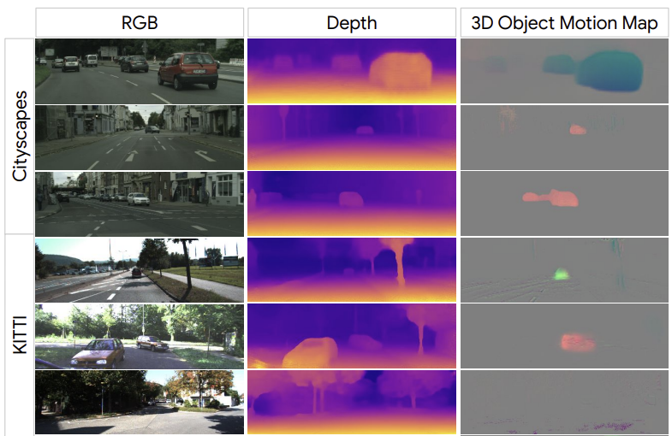
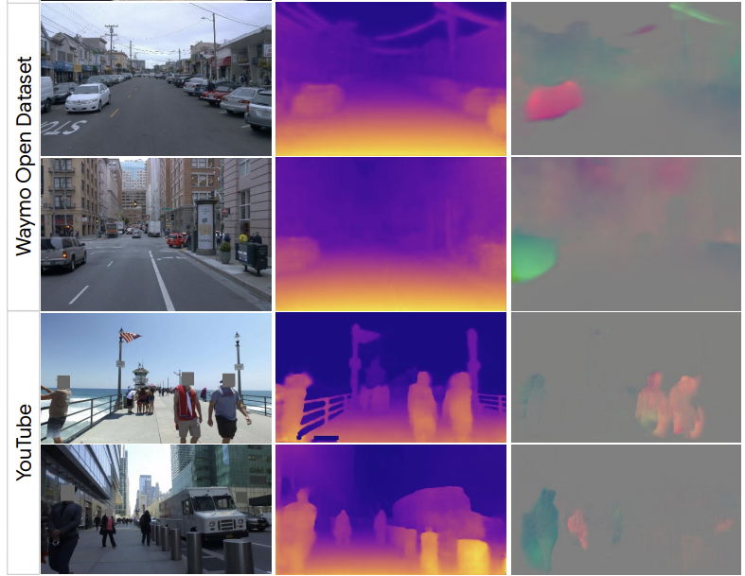
Li, Hanhan, et al. "Unsupervised monocular depth learning in dynamic scenes." Conference on Robot Learning. PMLR, 2021.
Introduction
> Cityscapes, KITTI, Waymo, YouTube
> Qualitative results – depth & 3D object motion map
Not need to segment out objects (to estimate motion)
Not assume stereo data
Directly regularizes motion in 3D → better accuracy
Notes:
They evaluate the performance of the method on four challenging datasets with dynamic scenes.
Our work provides a more general way of performing unsupervised depth learning in dynamic scenes;
unlike previous work, we do not need to segment out objects in order to estimate their motion, nor do we assume stereo data.
Unlike prior work that uses residual optical flow to reason about moving objects and occlusions, their method directly regularizes motion in 3D, which turns out to lead to better depth prediction accuracy

Slide 5
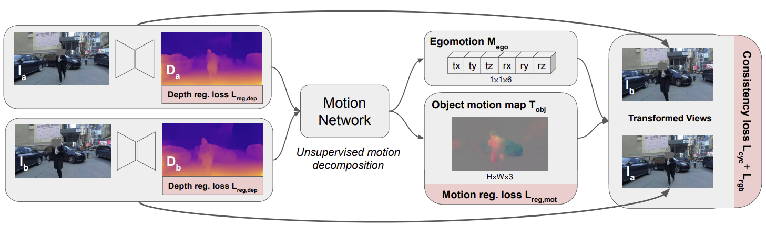
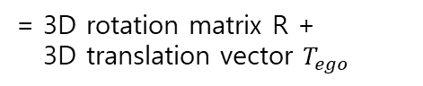


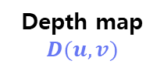
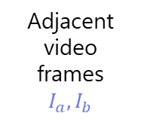
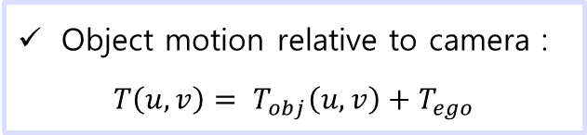
Li, Hanhan, et al. "Unsupervised monocular depth learning in dynamic scenes." Conference on Robot Learning. PMLR, 2021.
Method
Overall training step
6D ego-motion vector
$$M_{ego}$$
= 3D rotation matrix R +
3D translation vector $T_{ego}$
A single frame
Depth map
$$D(u,v)$$
Adjacent video frames
$$I_{a}, I_{b}$$
Motion Network
Depth network
concatenate
Object motion relative to camera :
$$T\left(u,v\right)= T_{obj}\left(u,v\right)+T_{ego}$$
3D translation map
$$T_{obj}(u,v)$$
depth, ego-motion, object motion
Object relative to scene
Scene relative to camera
Notes:
In our approach, depth, ego-motion, and object motion are learned simultaneously from monocular videos using self-supervision
They use pairs of adjacent video frames (Ia and Ib) as training data
Our depth network predicts a depth map D(u, v) (where u and v are the image coordinates) at the original resolution from a single image,
and we apply it independently on each of the two frames. The two depth maps are concatenated with Ia and Ib in the channel dimension and are fed into a motion prediction network (Figure 1).
Motion network predicts a 3D translation map Tobj(u, v) at the original resolution for the moving objects and a 6D ego-motion vector Mego.
The object motion relative to the camera is defined as rotation R followed by a translation

Slide 6
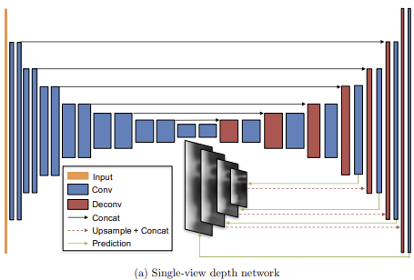
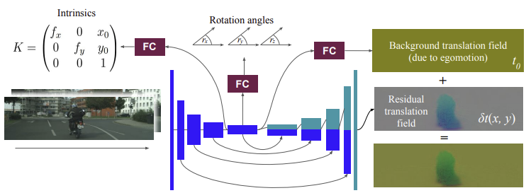
Li, Hanhan, et al. "Unsupervised monocular depth learning in dynamic scenes." Conference on Robot Learning. PMLR, 2021.
Method
Depth and Motion Networks
Depth network
Encoder-decoder architecture
Motion network
Input : pair of consecutive frames 연속적인 프레임
4 channels = 3 RGB + predicted depth
Ref) Zhou, Tinghui, et al
“Unsupervised Learning of Depth and Ego-Motion from Video”
Ref) Gordon, Ariel, et al. "Depth from videos in the wild: Unsupervised monocular depth learning from unknown cameras."

Slide 7
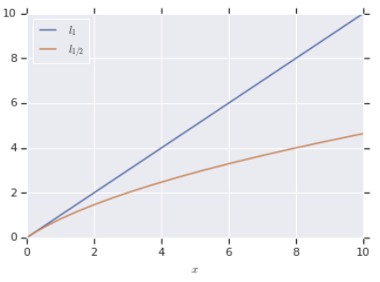

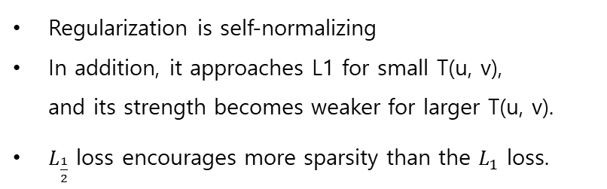
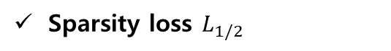
Li, Hanhan, et al. "Unsupervised monocular depth learning in dynamic scenes." Conference on Robot Learning. PMLR, 2021.
Method
Losses
Motion Regularization
Group smoothness loss + sparsity loss
> Visualize the effect of the square root norm
Group smoothness loss $L_{g1}$
Sparsity loss $L_{1/2}$
Minimizes changes within the moving areas, encouraging the motion map to be nearly constant throughout a moving object
Moving area의 변화를 최소화 → Moving object 전체에서 motion map이 일정하게 유지되도록 한다
This is done in expectation that moving objects are mostly rigid
Regularization is self-normalizing
In addition, it approaches L1 for small T(u, v), and its strength becomes weaker for larger T(u, v).
$L_{\frac{1}{2}}$ loss encourages more sparsity than the $L_{1}$ loss.
Piecewise-constant $T_{obj}\left(u,v\right)$ can describe any scene where objects are moving in pure translation relative to the background
→ However, when object are rotating = residual translation field is generally not constant
→ Since fast rotation of objects are uncommon, expect approximation to be appropriate
Notes:
The group smoothness loss Lg1 on T_obj(u, v) minimizes changes within the moving areas, encouraging the motion map to be nearly constant throughout a moving object. This is done in anticipation that moving objects are mostly rigid.

Slide 8

Li, Hanhan, et al. "Unsupervised monocular depth learning in dynamic scenes." Conference on Robot Learning. PMLR, 2021.
Method
Losses
Depth Regularization $L_{reg,dep}$
Consistency Regularization
→ Standard edge-aware smoothness regularization on the disparity maps d(u, v)
→ The regularization is weaker around pixels where color variation is higher
→ 색 변화가 큰 픽셀에서는 regularization이 더 약함
Motion cycle consistency loss $L_{cyc}$
→ encourages the forward and backward motion between any pair of frames to be the opposite of each other.
Occlusion-aware photometric consistency loss $L_{rgb}$
→ encourages photometric consistency of corresponding areas in the two input frames
→ L1 loss + SSIM structural similarity loss in the RGB space
Notes:
They apply a standard edge-aware smoothness regularization on the disparity maps d(u, v) as described in Godard et al. [27].
In other words, the regularization is weaker around pixels where color variation is higher:
The consistency regularization is the sum of the motion cycle consistency loss Lcyc and the occlusion-aware photometric consistency loss Lrgb
Lcyc encourages the forward and backward motion between any pair of frames to be the opposite of each other.
Lrgb encourages photometric consistency of corresponding areas in the two input frames. Similar to prior works, it is a sum of a L1 loss and a SSIM structural similarity loss in the RGB space

Slide 9
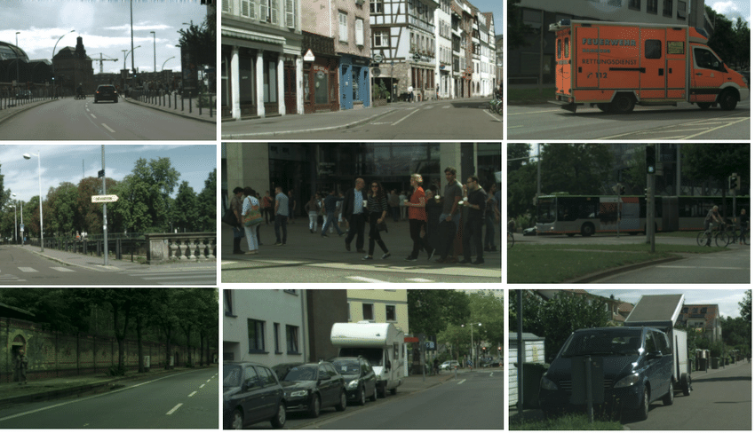
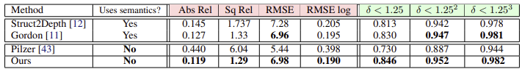
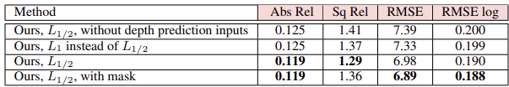
Li, Hanhan, et al. "Unsupervised monocular depth learning in dynamic scenes." Conference on Robot Learning. PMLR, 2021.
Experiments
Cityscapes
Urban driving dataset - prevalence of dynamic scenes → challenging for unsupervised monocular depth estimation
> Performance comparison of unsupervised single-view depth learning approaches
416×128
input, output
Not use semantic information
Outperform except RMSE
> Ablation study on Cityscapes
→ Use L1 -> ‘Abs Rel’ increased (worser)
→ the detection model does not cause
noticeable improvements for depth estimation
‘With mask’ = use pretrained detection model to
identify regions of potentially moving objects
Notes:
The Cityscapes [15] dataset is an urban driving dataset, which is quite challenging for unsupervised monocular depth estimation, because of the prevalence of dynamic scenes.
Red metrics, lower is better / Green metrics, higher is better.
‘with mask’ means using a pretrained segmentation model to identify regions of potentially moving objects,

Slide 10
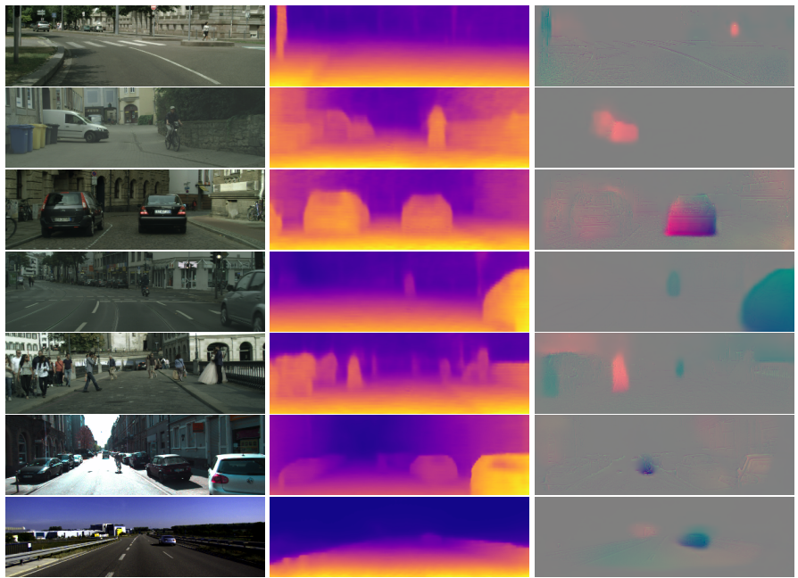
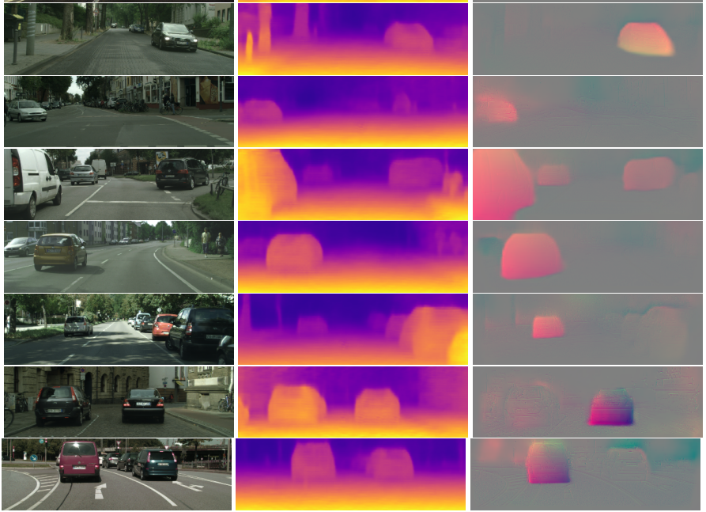
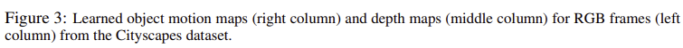
Li, Hanhan, et al. "Unsupervised monocular depth learning in dynamic scenes." Conference on Robot Learning. PMLR, 2021.
Experiments
Cityscapes

Slide 11
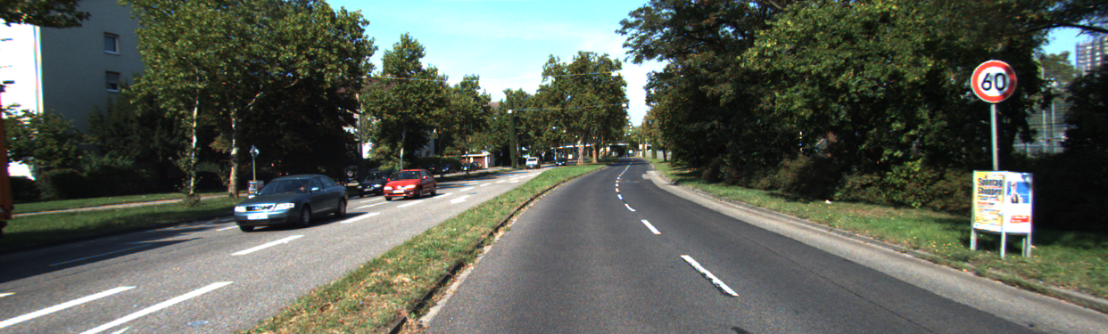
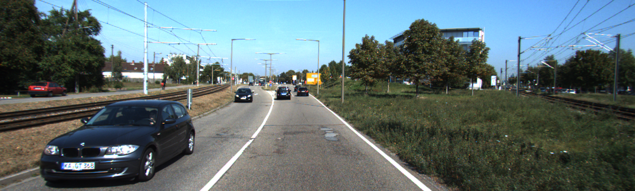
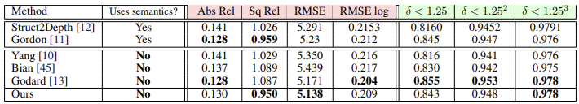
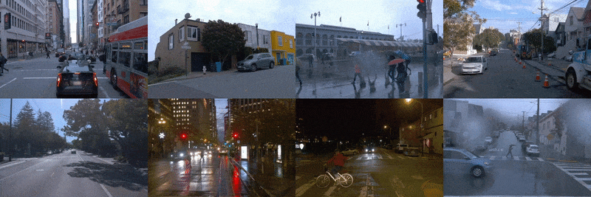
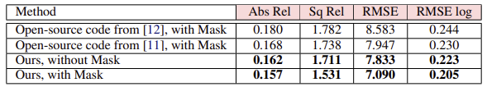
Li, Hanhan, et al. "Unsupervised monocular depth learning in dynamic scenes." Conference on Robot Learning. PMLR, 2021.
Experiments
KITTI
Urban environments – popular benchmark for depth and ego-motion estimation
Evaluation = + LiDAR data
A small number of dynamic scenes → a very common dataset for evaluating depth models
> Performance comparison of unsupervised single-view depth learning approaches
416×128
input, output
Waymo Open Dataset
Dynamic scenes + nighttime driving + diverse weather condition
Evaluation – ground truth depth from LiDAR
Notes:
The KITTI [17] dataset is collected in urban environments and is a popular benchmark for depth and ego-motion estimation. . It is accompanied with LiDAR data, which is used for evaluation only
The Waymo Open Dataset [16] is currently one of the largest and most diverse publicly released autonomous driving datasets. Its scenes are not only dynamic but also comprise nighttime driving and diverse weather conditions.
Their approach outperforms prior work, even though it does not require masks (top portion). With masks, it performs even better (bottom).

Slide 12
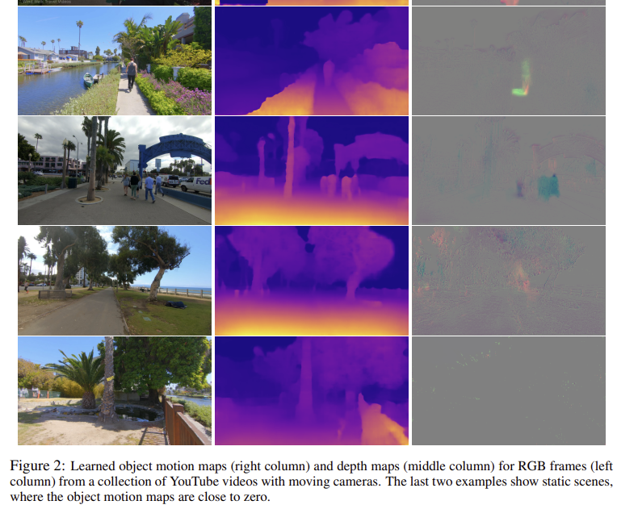
Li, Hanhan, et al. "Unsupervised monocular depth learning in dynamic scenes." Conference on Robot Learning. PMLR, 2021.
Experiments
YouTube videos
To demonstrate that depth can be learned from videos in the wild → randomly picked a collection of videos on YouTube taken with handheld cameras while walking
Unknown camera → learn intrinsics matrix per video
4 trainable variables
2 focal lengths
2 optical centers
static scenes

Slide 13
Li, Hanhan, et al. "Unsupervised monocular depth learning in dynamic scenes." Conference on Robot Learning. PMLR, 2021.
Conclusion
A novel unsupervised method for depth learning in highly dynamic scenes 동적인 장면들 depth 추정
Jointly solves for 3D motion maps and depth maps
Model can be trained on unlabeled monocular videos without requiring any auxiliary semantic information
Method is very simple → Use end-to-end differentiable losses
Encourage photometric consistency, motion smoothness, motion sparsity
Limitation
Object rotation and deformation is not explicitly handled 물체 회전, 변형이 명확하게 처리되지 않음
Camera movement needs to be present to receive learning signals 카메라 움직임이 있어야 함
Notes:
This paper presents a novel unsupervised method for depth learning in highly dynamic scenes, which jointly solves for 3D motion maps and depth maps.
Our model can be trained on unlabeled monocular videos without requiring any auxiliary semantic information.
Our method is conceptually very simple, as we use end-to-end differentiable losses that encourage photometric consistency, motion smoothness, and motion sparsity.
The main limitation is that object rotation and deformation is not explicitly handled, and that camera movement needs to be present to receive learning signals.
We demonstrate the efficacy of the proposed approach on Cityscapes, KITTI, the Waymo Open Dataset, and YouTube data. For datasets rich in dynamic scenes, we outperform prior depth estimation benchmarks, including ones that utilize semantic cues.

Slide 14
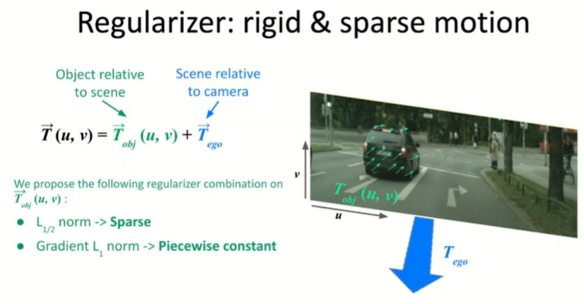
Li, Hanhan, et al. "Unsupervised monocular depth learning in dynamic scenes." Conference on Robot Learning. PMLR, 2021.
Method
> Recognize object map without semantic cues
Sparse
Piecewise constant
# Piecewise constant
배경 = 0
물체 안에서는 constant
다른 물체 있으면 그 안에서도 constant
https://www.youtube.com/watch?v=hHlU5G-ONwM

Slide 15
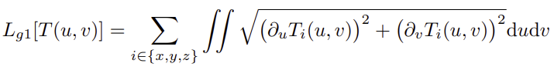
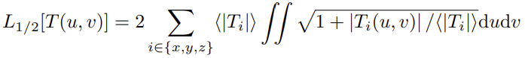
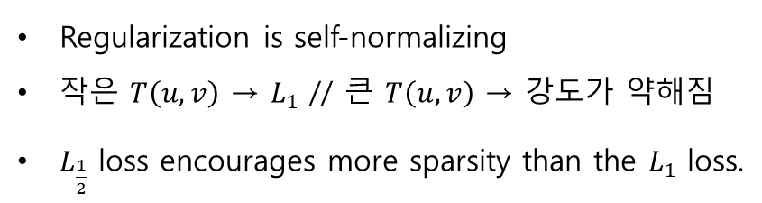
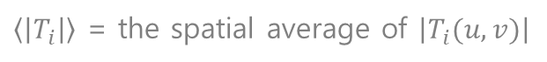
Li, Hanhan, et al. "Unsupervised monocular depth learning in dynamic scenes." Conference on Robot Learning. PMLR, 2021.
Method
Losses
Motion Regularization
> Group smoothness loss
Moving area의 변화를 최소화
→ Moving object 전체에서 motion map이 일정하게 유지되도록 한다.
Moving objects가 rigid 일거라 예상하여 수행됨
> Sparsity loss
Regularization is self-normalizing
작은 $T\left(u,v\right)$ → $L_{1}$ // 큰 $T\left(u,v\right)$ → $강도가$ 약해짐
$L_{\frac{1}{2}}$ loss encourages more sparsity than the $L_{1}$ loss.
$\left\langle \left|T_{i}\right|\right\rangle$ = the spatial average of $\left|T_{i}(u,v)\right|$
Piecewise-constant $T_{obj}\left(u,v\right)$ : 물체가 배경에 대해 pure translation으로 움직이는 모든 장면을 표현할 수 있다
→ But rotating 회전 = residual translation field 일정하지 않음
→ 흔하지 않기 때문에 근사치가 적절할 것으로 기대
Notes:
The group smoothness loss Lg1 on T_obj(u, v) minimizes changes within the moving areas, encouraging the motion map to be nearly constant throughout a moving object. This is done in anticipation that moving objects are mostly rigid.

Slide 16
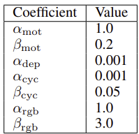
Li, Hanhan, et al. "Unsupervised monocular depth learning in dynamic scenes." Conference on Robot Learning. PMLR, 2021.
Method
Losses
Depth Regularization
→ Standard edge-aware smoothness regularization on the disparity maps d(u, v)
→ 색 변화가 큰 픽셀에서는 regularization이 더 약함
> hyperparameters
Consistency Regularization
> Motion cycle consistency loss
→ encourages the forward and backward motion between any pair of frames to be the opposite of each other.
> Occlusion-aware photometric consistency loss
→ encourages photometric consistency of corresponding areas in the two input frames
→ L1 loss + SSIM structural similarity loss

Slide 17
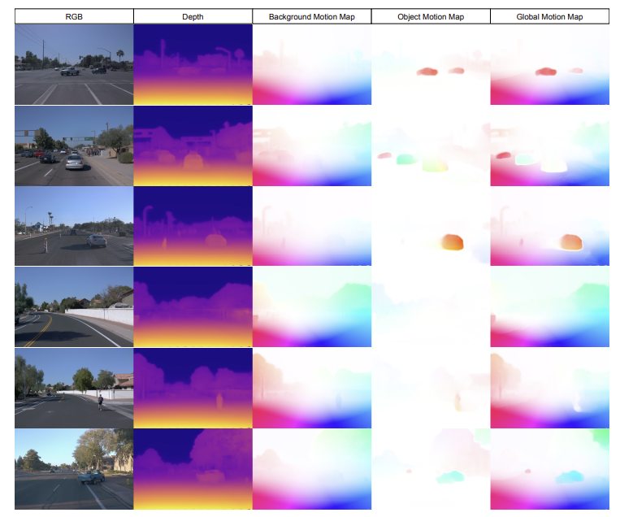
Li, Hanhan, et al. "Unsupervised monocular depth learning in dynamic scenes." Conference on Robot Learning. PMLR, 2021.
Experiments
Waymo Open Dataset
This figure shows RGB images, depth maps, and the 2D-appearance flows projected from 3D motion maps on the Waymo Open Dataset.
Here, we colorize based on flow direction with intensity corresponding to flow magnitude.
Using our depth and background motion estimate, we can derive 2D appearance flow of static parts of the scene (middle).
We can use the same procedure to visualize our object motion field and their global composite (right), respectively.

